Slide 1


Part 1 - OVS + Namespaces Setup
May 13, 2025, | University of Pisa, Italy
Samiullah Khairy

Slide 2
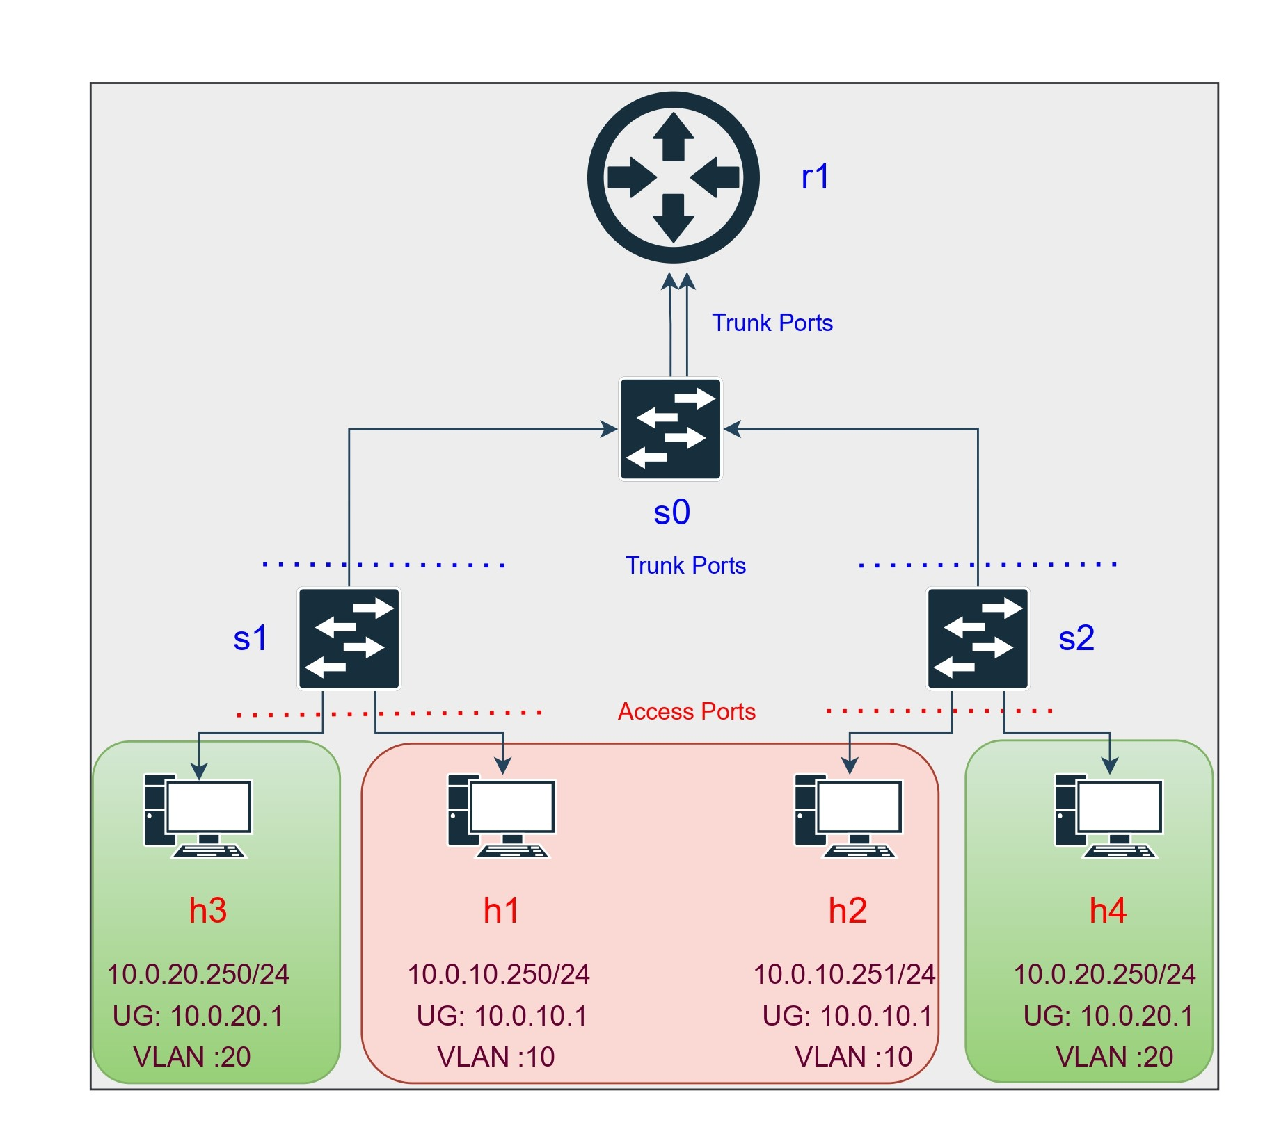
OpenvSwitch and NameSpaces Topology
Hosts: h1, h2 (VLAN 10), h3, h4 (VLAN 20)
• Bridges: br-access1, br-access2, br-core
• VLAN tags:
- h1/h2: tag=10
- h3/h4: tag=20
• Router VLAN sub-interfaces
- router-core.10: 192.168.10.1
- router-core.20: 192.168.20.1
• Enabled IP forwarding

Slide 3
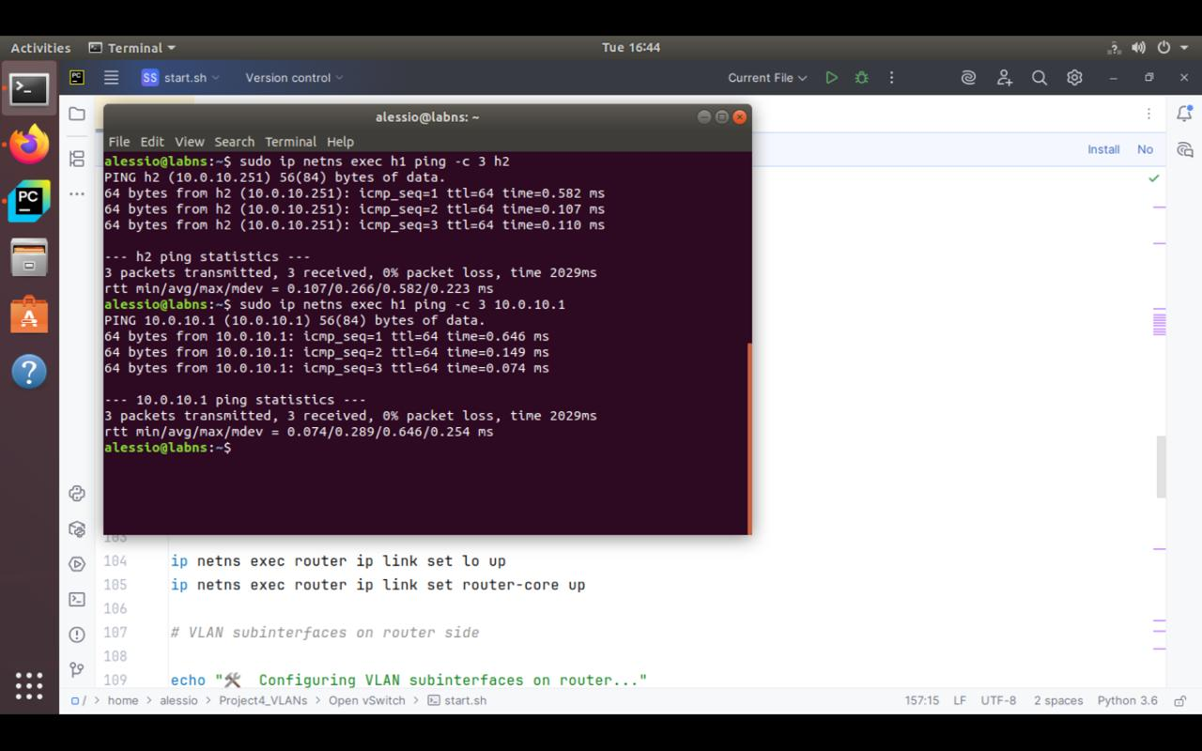
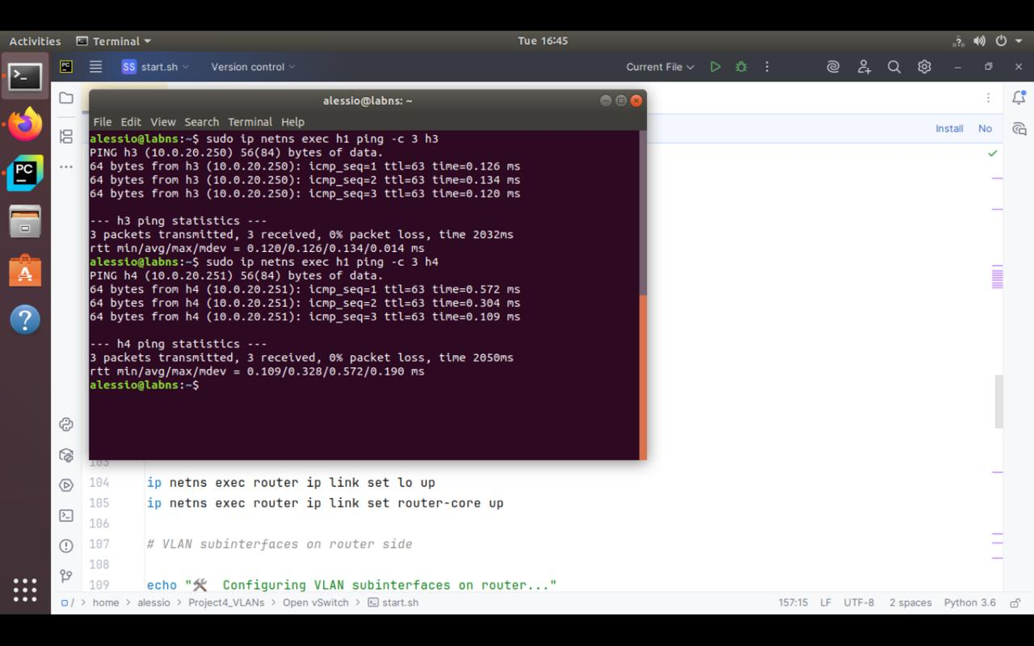
OpenvSwitch and NameSpaces Tests
• Intra-VLAN communication via router
• Inter-VLAN communication via router
• Ping and iperf tests passed
• Custom /etc/hosts for name resolution

Slide 4
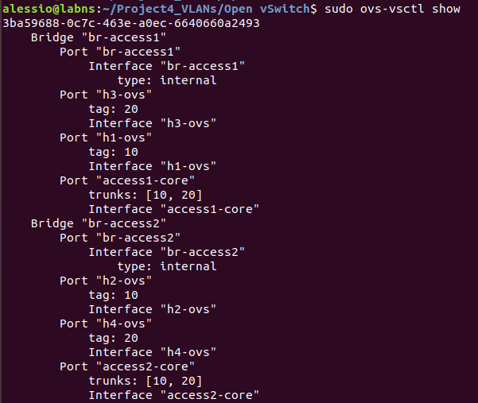
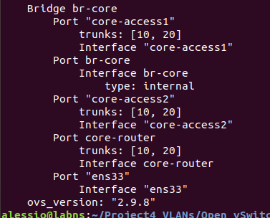
OVS show
• VLAN tagging in access
Switches And core switch.

Slide 5
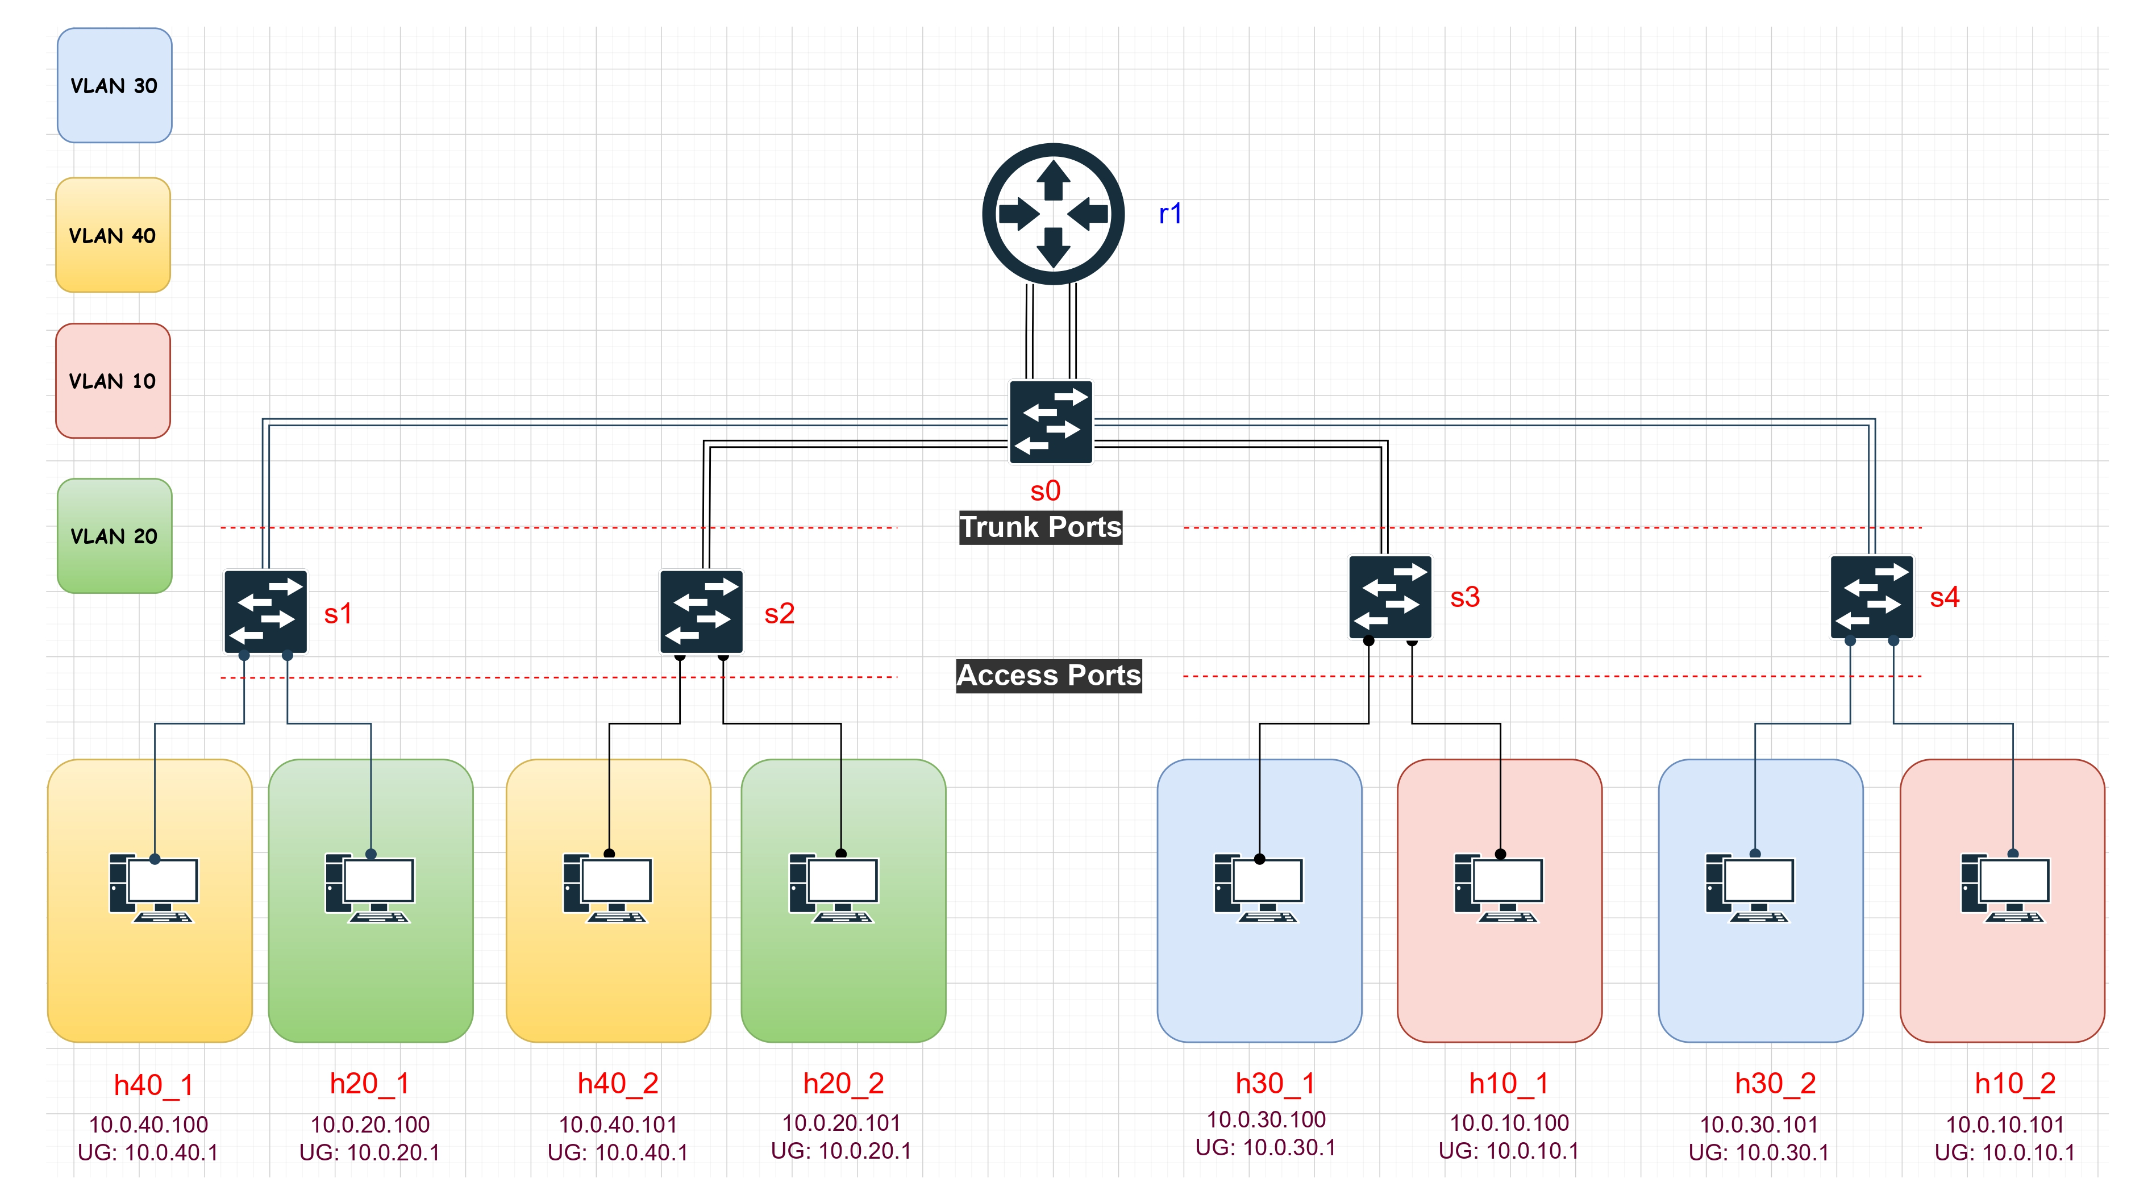
Part 2 - Mininet with arbitrary number of VLANs
Hosts from the same VLAN are distributed across multiple switches
Inter-VLAN routing is handled by a Linux router using sub-interfaces
VLAN tags are applied per-port dynamically based on host VLAN

Slide 6
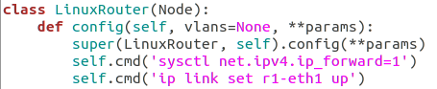
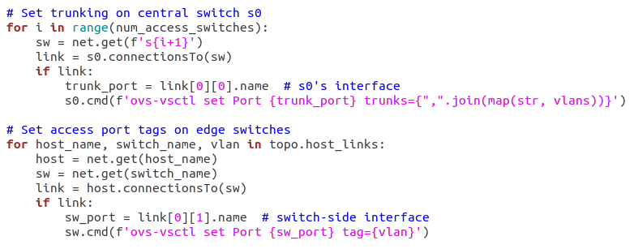
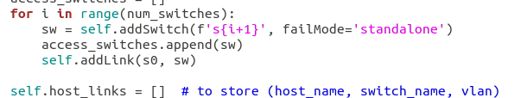
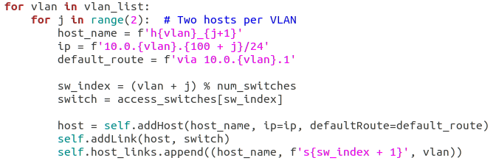
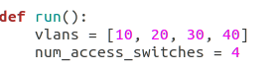
Part 2 - Mininet VLAN Setup code
Router added using the node Class
Setting tagging the frames in switches
Creating the Arbitrary switches
Adding the hosts and default gateways
Assigning number of Switches and VLANs

Slide 7
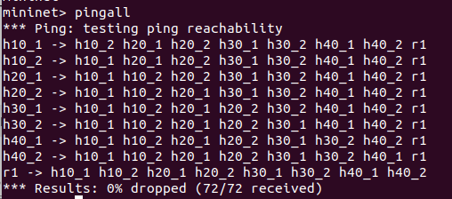
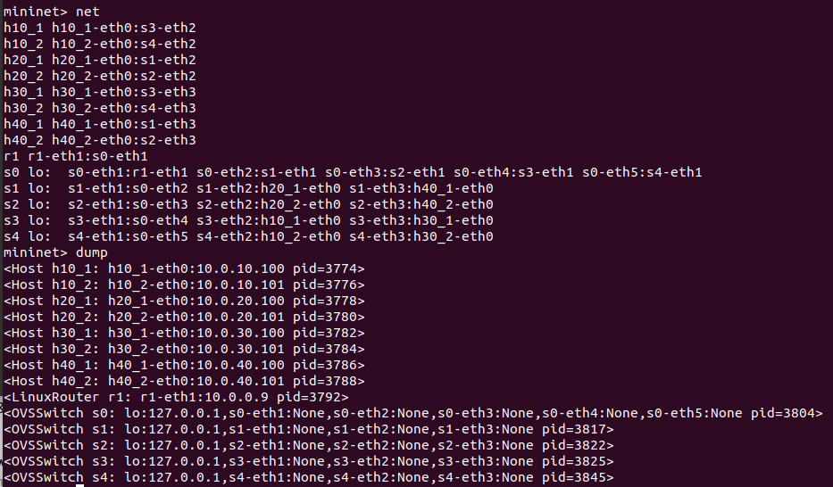
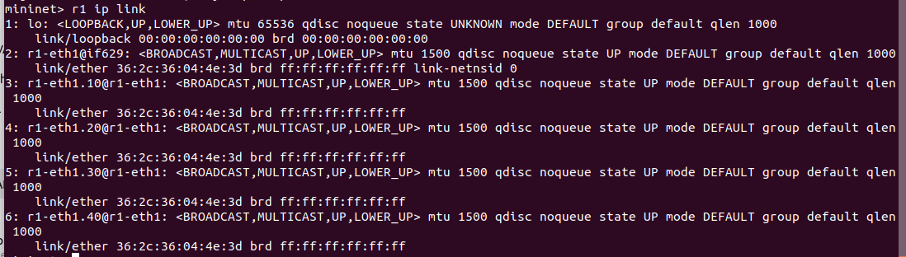
Part 2 - Mininet VLAN Setup
CLI launched
host bindings, and interface mappings in Mininet
Router sub-interfaces:

Slide 8
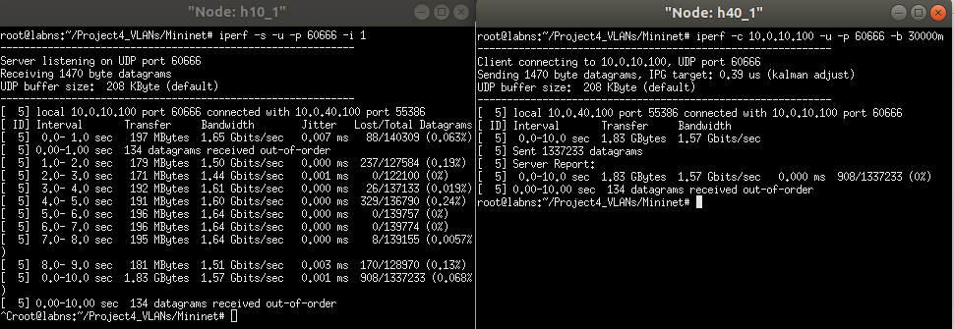
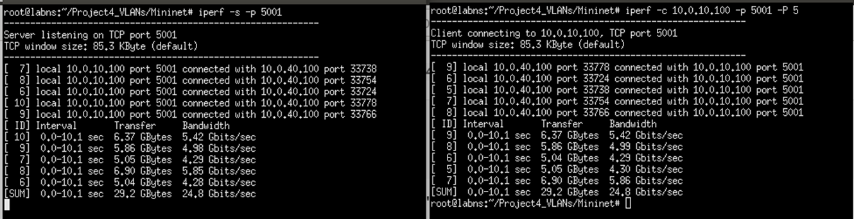
Iperf and Ping connectivity
server
Client
server
Client

Slide 9
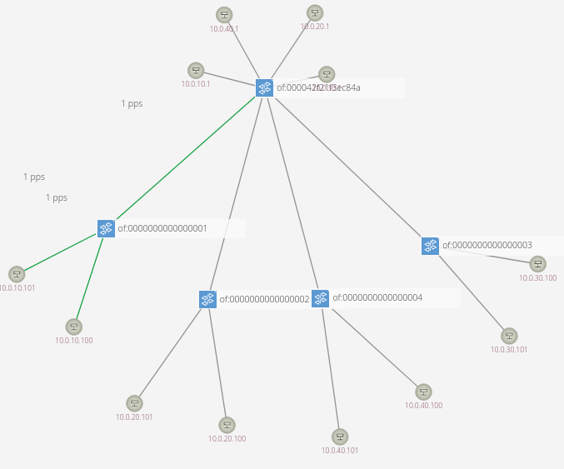
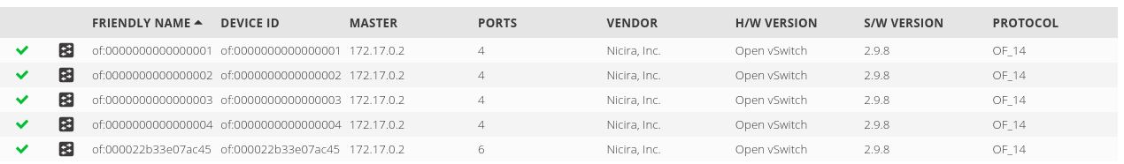
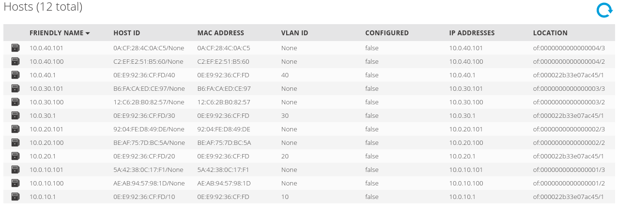
ONOS

Slide 10


